Slide 1
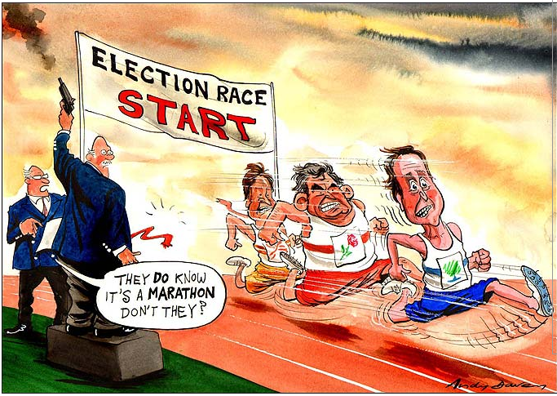
UKElection 2010

Slide 2
DefiningFeatures
ELECTORAL SYSTEM: Single Member District Plurality [aka First Past the Post]
Districts = Constituencies
Indirect Election of the Executive
PARTY SYSTEM: Two Party Plus
VOTER BEHAVIOR: Class, Region, Gender + Tactical Voting
First Past the Post v. AV System
http://www.youtube.com/watch?v=BoKlE1_vrYU

Slide 3
ElectionReform
First Past the Post v. Alternative Voting
AV Referendum FAILED 2011
Fixed Term Parliament Act PASSED 2011
Next election is May 7, 2015
Two provisions that trigger an early election
A motion of no confidence is passed
A motion for a general election is agreed by two thirds of the total number of seats in the Commons including vacant seats (currently 434 out of 650)
Previous to this act, the duration of a Parliament was set at five years, although many were dissolved before that, at the request of the Prime Minister to the Queen. (From UK Parliament website)

Slide 4
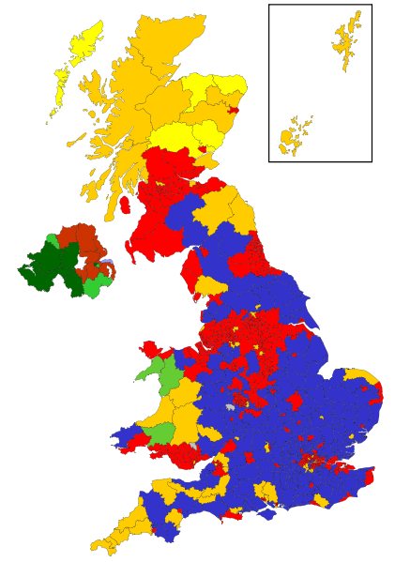
2005
General
Election
Conservatives
Labour
Lib Dems
Scottish Nationalists
Sinn Fein
Plaid Cymru
What are elections?
(UK Parliament Video)
http://www.youtube.com/watch?v=IRx_IsLBhYA

Slide 5
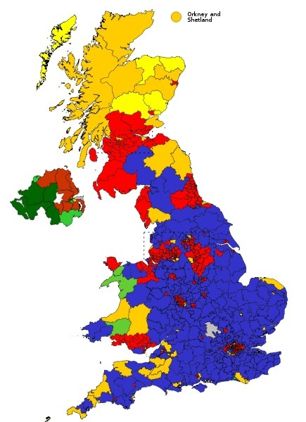
2005
General
Election
2010
General
Election

Slide 6
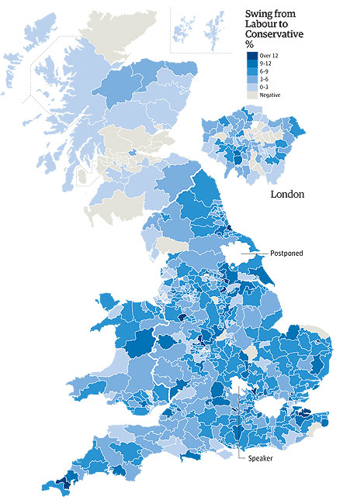
Voter Swing:
Labour to
Conservative
2010

Slide 7
3%
50%
46%
What factors have accounted for this electoral change in the UK?
32%

Slide 8
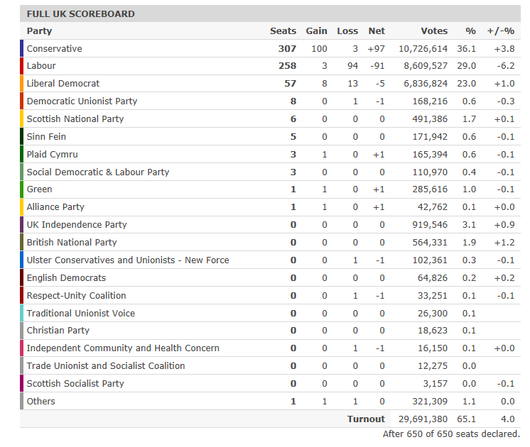
DEVOLUTION in Scotland, Wales & Northern Ireland
has given minor parties a chance to organize, campaign and get elected!

Slide 9
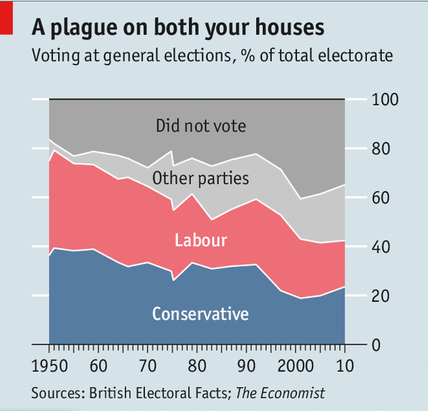

Slide 10
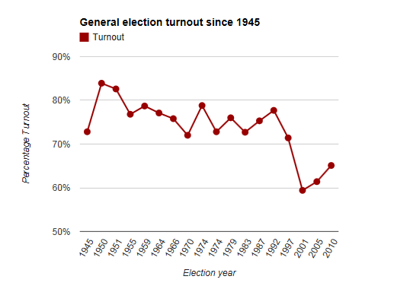

Slide 11
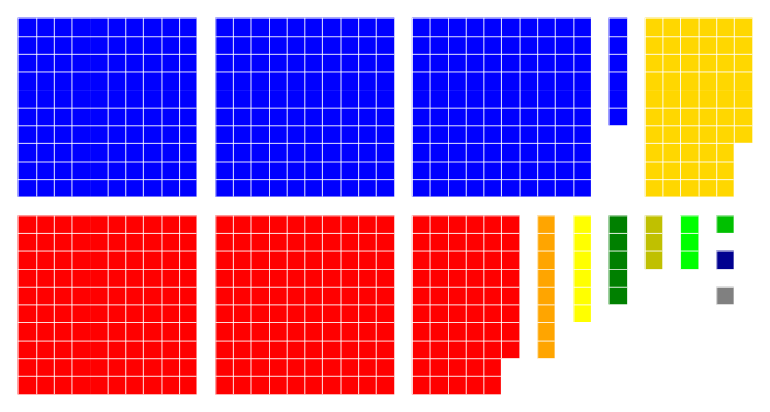
Conservatives: 307 [+97]
Labour: 258 [-91]
Lib Dems: 57 [-5]
The Result:
Hung Parliament
http://www.parliament.uk/mps-lords-and-offices/mps/state-of-the-parties/

Slide 12
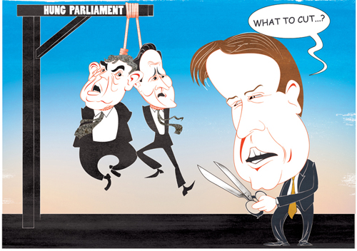
The Impact: Hung Parliament

Slide 13
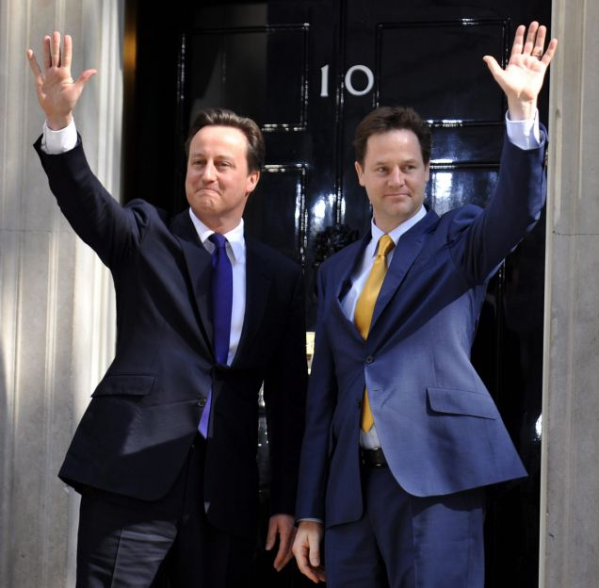
The Impact: Coalition Government
After 6 days of negotiations, the Liberal Dems became a party of power v. a party of protest.

