Slide 1
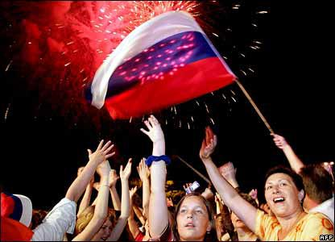
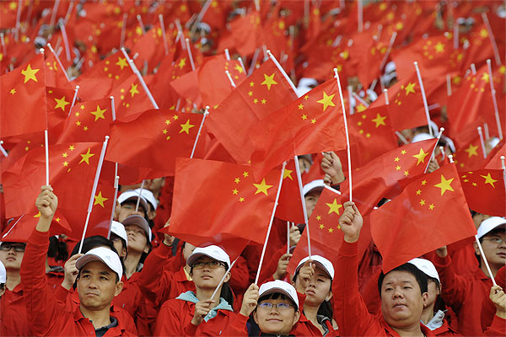
COMPARING
CONFLICT
Russia
China

Slide 2
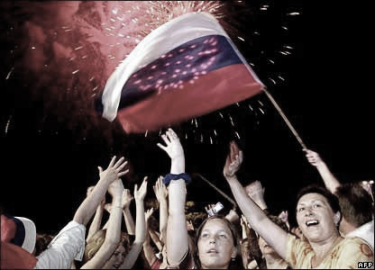
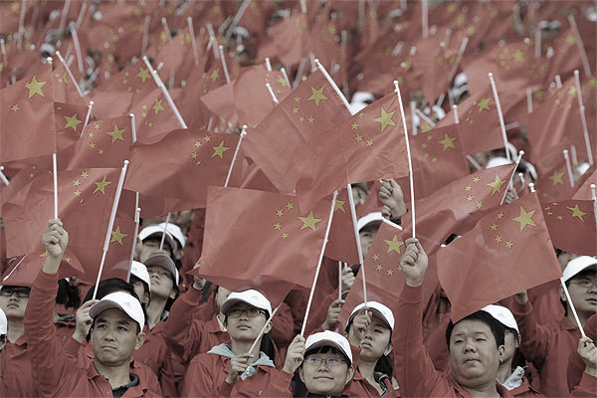
What are the internal and external sources of conflict for each government?
How does government attempt to resolve conflict?
How are the conflicts related to social cleavages?

Slide 3
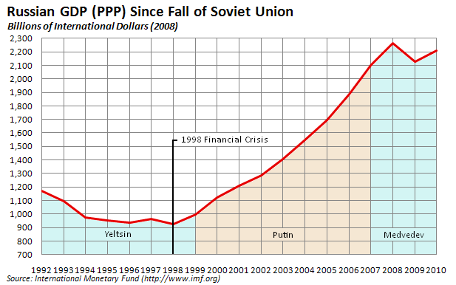
Conflict: Economy
Perestroika
to Shock
Therapy
Describe the difference between these two terms.

Slide 4
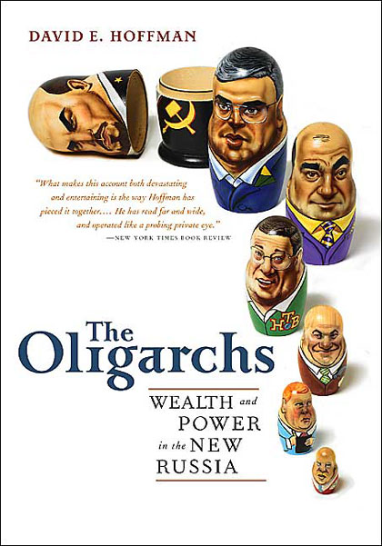
“Insider Privatization”
1992 Vouchers
led to the
Rise of the Oligarchs
1998 GDP
54% from 1989
in the Mafia

Slide 5
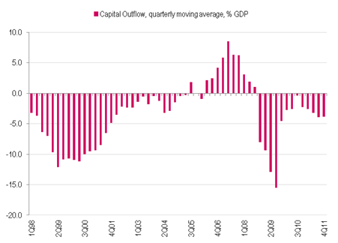
Conflict: Economy
Transition from a Command Economy
Capital Flight in 2nd Quarter of 2012 hit $22 B = 200% increase from 2011
Hyperinflation, Ruble Devaluation,
Debt Trap, Loan Default, Capital Flight

Slide 6
Conflict: Economy
Increasing Kremlin Ownership
Oil Dependency
Unemployment
Income Inequality

Slide 7
Conflict: Economy
Bright Spots for Russia
WTO, G-8, BRIC Nation
Skilled, Educated Workforce
Growing Middle Class

Slide 8
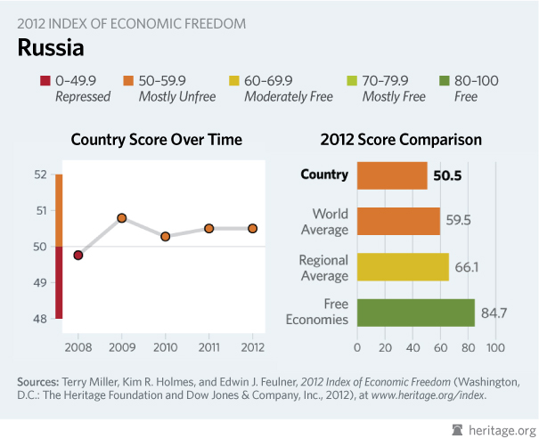
Conflict: Economy

Slide 9
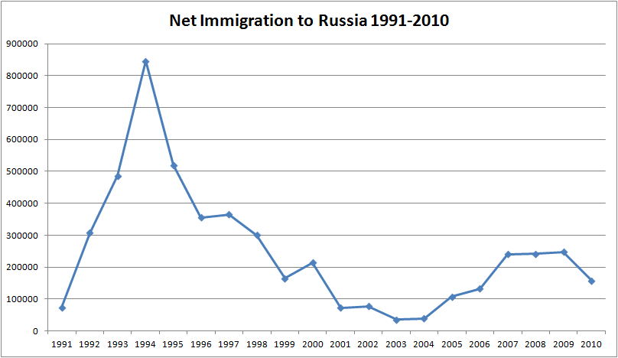
Conflict: Economy

Slide 10
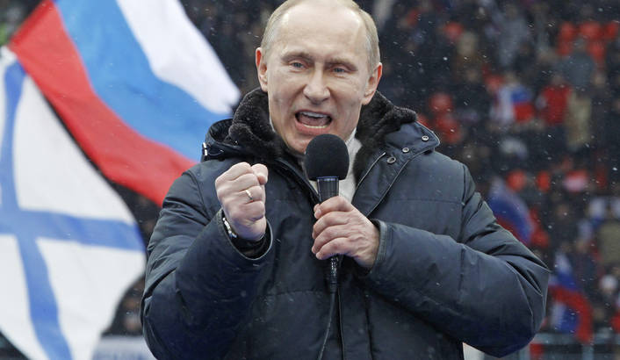
Conflict: Economy
Under Putin
Moscow has the world’s largest number of billionaires…
the Governor of Siberia lives in the UK…

Slide 11
Conflict: Economy in China
In the 1970’s the private sector was almost non-existent
Today the true numbers are hard to know, somewhere bt. 30% - 70% of GDP is run by the “private sector”
Deng Xiaoping learned that only a dynamic, growing economy would keep the CCP in control!
“Is does not matter if the cat is black or white, as long as it catches mice!” – Deng Xiaoping (1961)

Slide 12
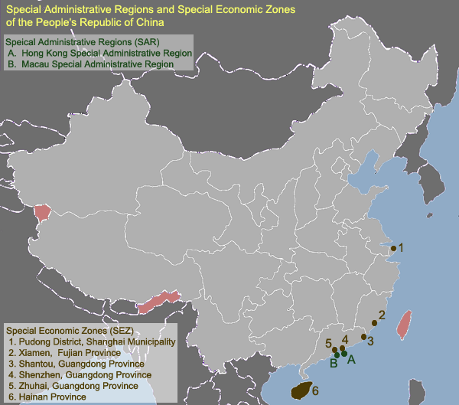
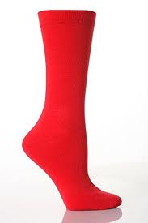
Conflict: Economy in China
Household Responsibility System (1979)
Special Economic Zones
TVEs (1984)
“One Country, Two Systems”
1979 – 1983
GDP triples!

Slide 13
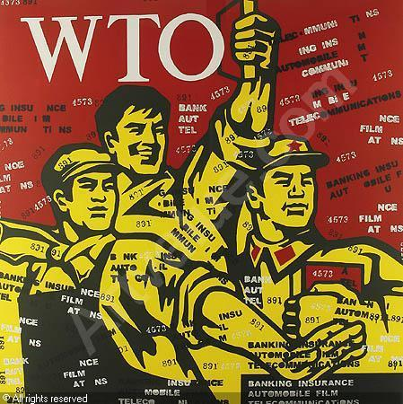
Conflict: WTO in 2001
CCP allows entrepreneurs and capitalists into the party
Uneasy, unstable alliance
Party cells planted in “private companies”
State Owned Enterprises

Slide 14
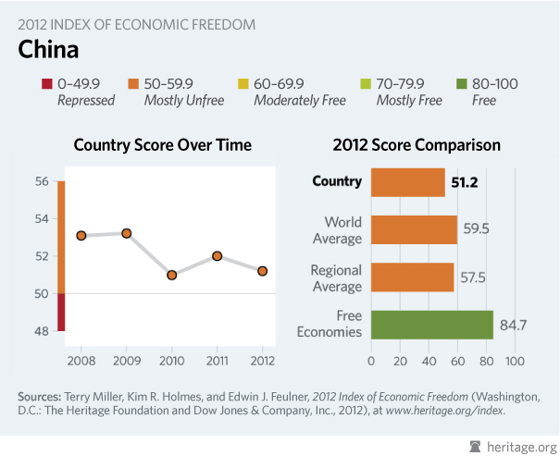
Conflict: Economy

Slide 15
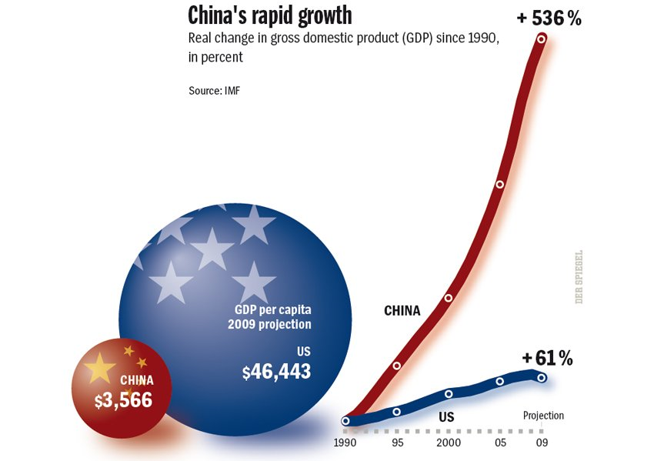
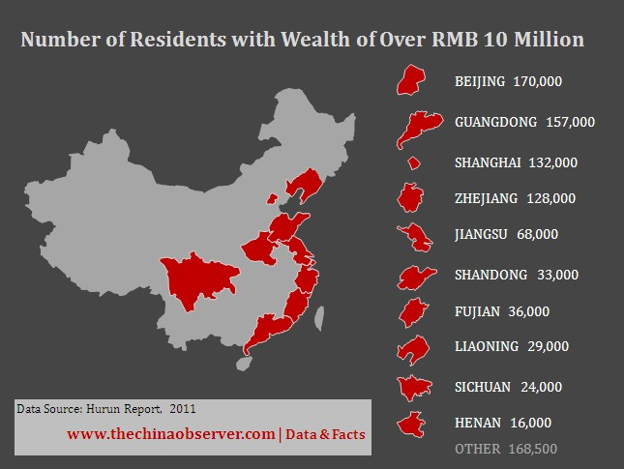
Conflict: Economy
WTO Membership
Patron-Client Relationships - “Guanxi”
“Iron Rice Bowl” = State Dependent Worker
Unemployment, Inequality of Wealth
Middle Class, Consumption

Slide 16
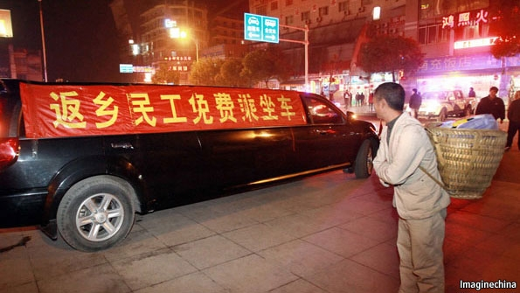
Conflict: Migration
http://www.economist.com/node/21548111

Slide 17
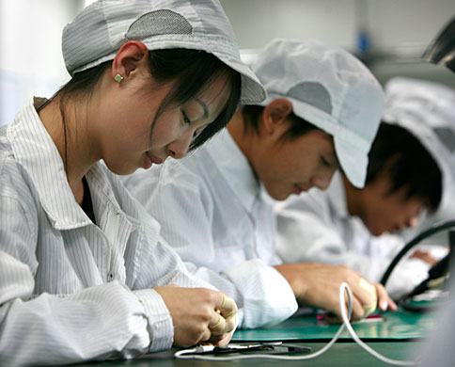
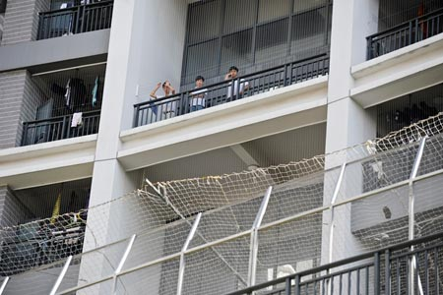
Conflict: Working Conditions
FOXCONN

Slide 18
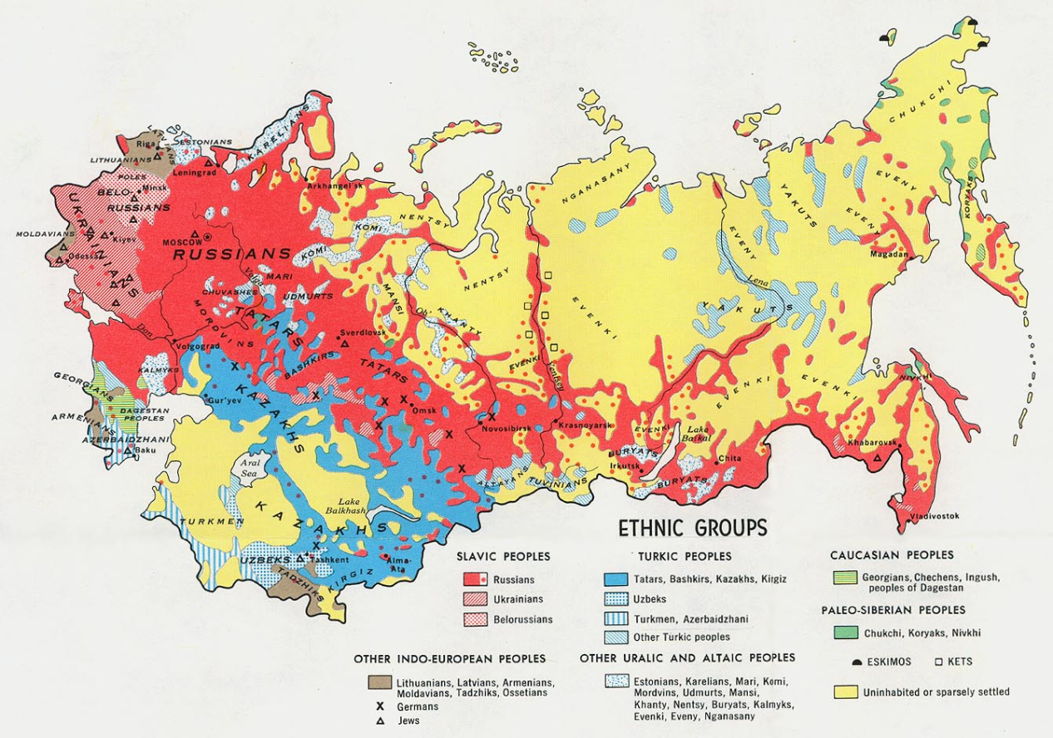
Social Cleavage: Ethnicity in Russia
100 Ethnic Groups, 200 languages, 11 time zones

Slide 19
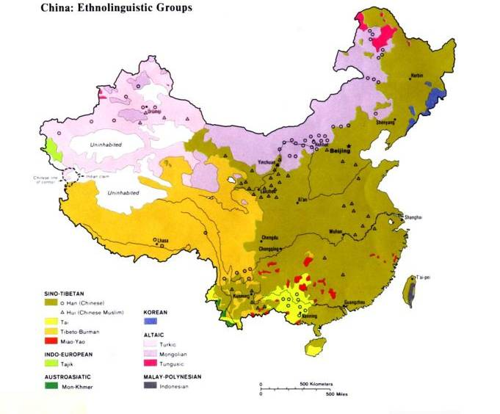
Social Cleavage: Ethnicity in China
92% Han Chinese, 8% other minorities (55 groups)

Slide 20
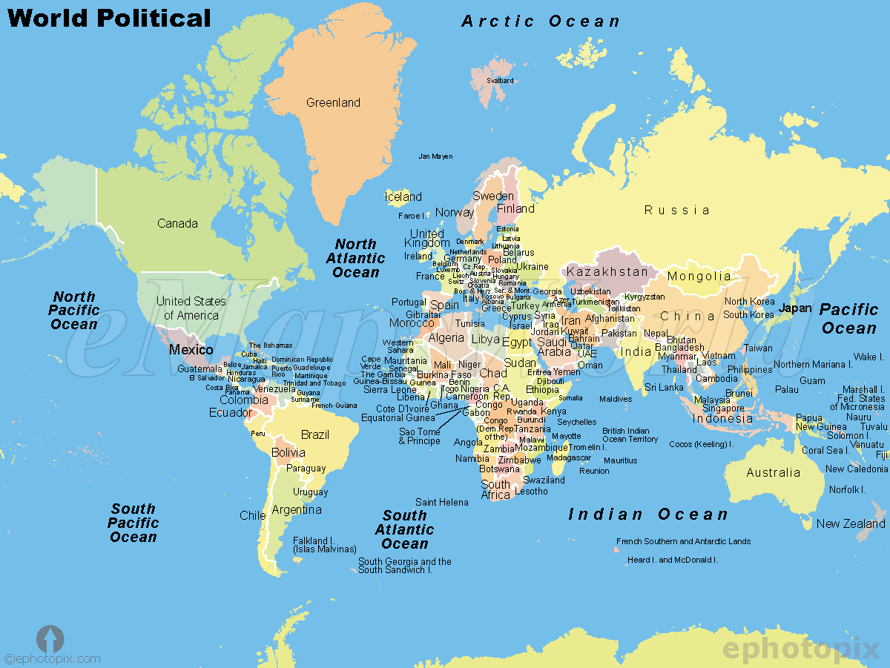

Slide 21
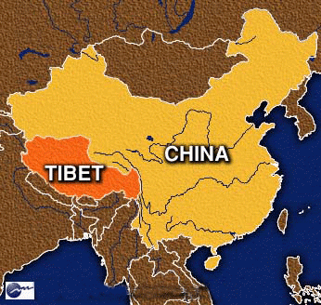
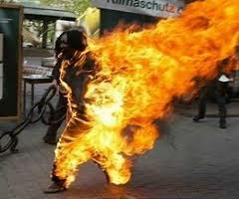
Social Cleavage: Tibet
“autonomous region”
CCP has moved Han Chinese into Tibet
Police carry automatic rifles

Slide 22
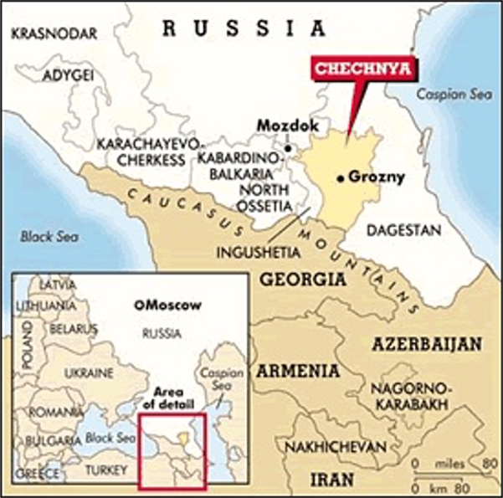
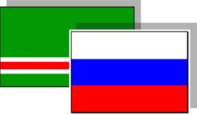
Conflict: Chechnya
War: “Hard Power”
1994-1996
1999-2005
2009: Russia Declares Victory
Putin needs a war!

Slide 23
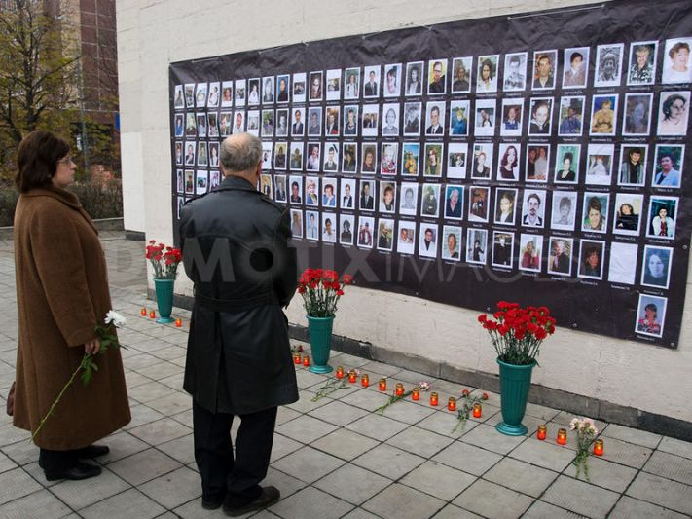
Conflict: Chechnya and Terrorism
Most recent data
2008 – 576 attacks
2009 – 786 attacks
2010 – 779 attacks
2011 – 365 attacks
Now rebuilding Grozny, no press allowed in
Moscow Theater Seize (2002)
117 civilians died from the gas

Slide 24
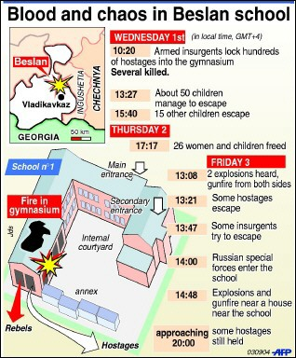
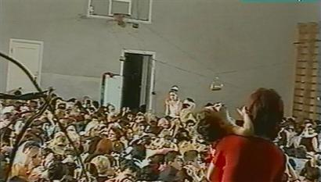
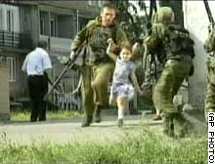
Conflict: Chechnya 2004 Beslan School
344 died (186 children)

Slide 25
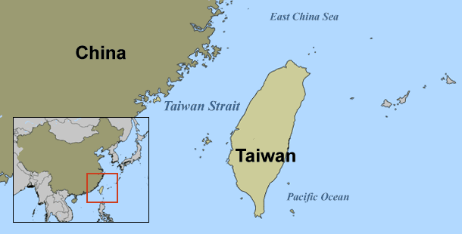
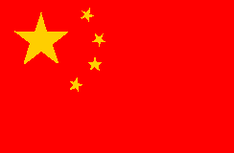
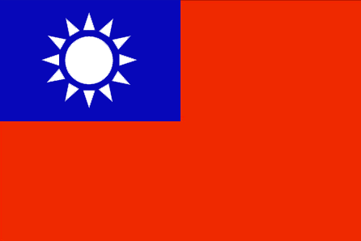
Conflict: Taiwan

Slide 26
Conflict: Taiwan
“Taiwan is an inalienable part of China's territory. The greatest threat to peace in the Taiwan Straits is from the splitist activities by the ‘Taiwan independence’ forces.”
Chinese President Hu Jintao, 2003

Slide 27
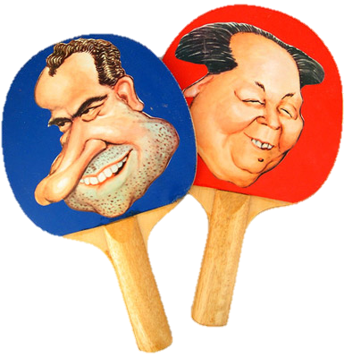
Conflict: Taiwan
1972: China-US
“One China” Policy
1979: Taiwan Relations Act
1992 Consensus (“One China,” sort of)
1999: “Two States” Theory
2001: China + “Chinese Taipei” into WTO
Notes:
In 1999, President Lee Teng-hui proposed a two-states theory (or a special state-to-state relations theory) in which both the ROC and PRC would be considered separate states with a special diplomatic, cultural and historic relationship, and gained immense support within Taiwan. This however drew an angry reaction from the PRC who believed that Lee was covertly supporting Taiwan independence.

Slide 28
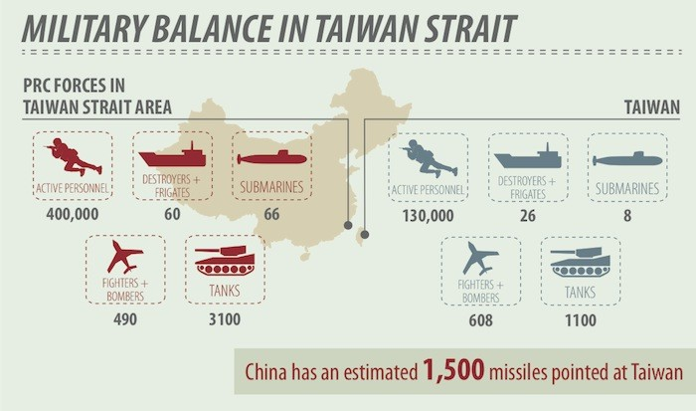
Conflict: Taiwan

Slide 29
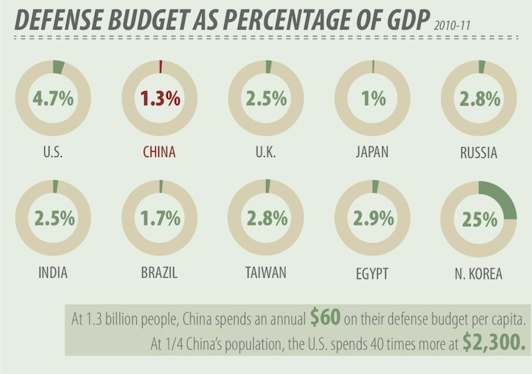
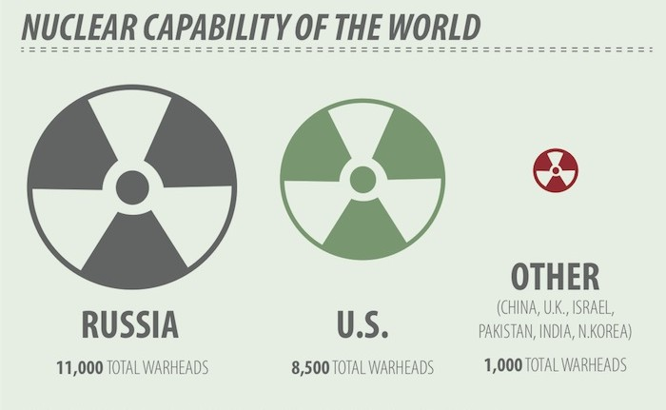
Conflict:
Military
Influence

Slide 30
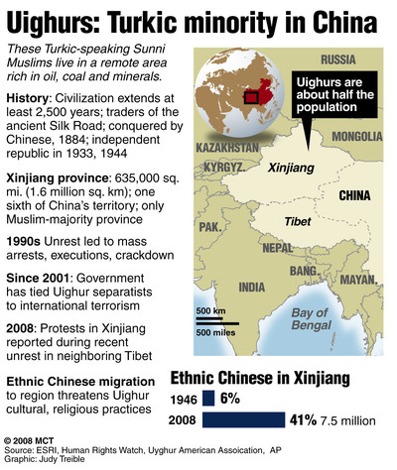
Social Cleavage: Ethnicity

Slide 31
225 million “Floating Population”
Conflict: Hukou
No hukou (household registration)
Without hukou , residents cannot sign lease, children cannot go to school and they cannot qualify for welfare.
Often they are blamed for urban crime
60 percent of migrant “floating workers” now bring their children to cities.

Slide 32
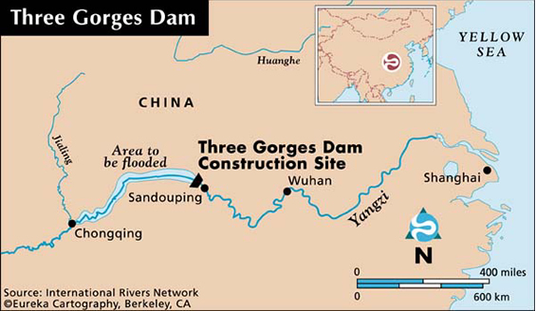
Conflict: Relocation and Three Gorges Dam
1/10 of all the electronic power of China
1.4 miles long, 600 feet above the river
1.3 Million relocated (4 Million more…)
$60 B (projected $25 B)
Rise of environmental NGO’s (large reservoir “sess pool”

Slide 33
Conflict: Relocation and Three Gorges Dam
Dream of Mao (self-sufficient with out foreign intervention)
1992 National People’s Congress
1787 – YES
177 – NO
664 – ABSTENTIONS
Why is this vote significant?

Slide 34
What are the internal and external sources of conflict for each government?
How does government attempt to resolve conflict?
How are the conflicts related to social cleavages?

