Slide 1
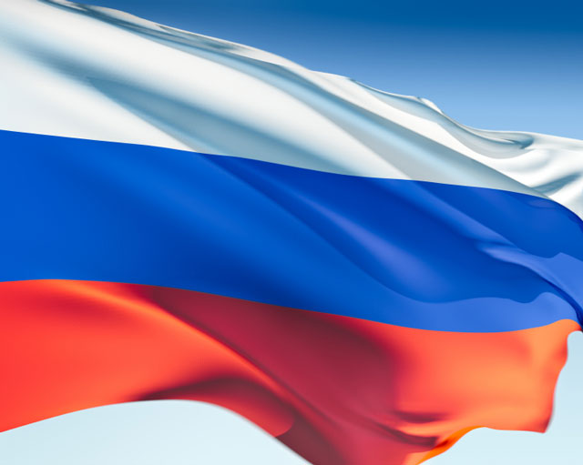
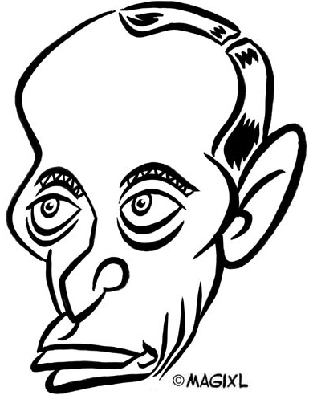
PUTIN,
Power,
and
Russia

Slide 2
Putin, Power and Russia
Using the articles you read last night (and from your book reading), identify the groups in Russia who support Putin and those who oppose him. Be ready to explain why!
http://www.youtube.com/watch?v=I2_7AfFCH-g&feature=plcp&list=PL0032D6F812394F45
http://www.youtube.com/watch?v=I2_7AfFCH-g&feature=plcp&list=PL0032D6F812394F45

Slide 3
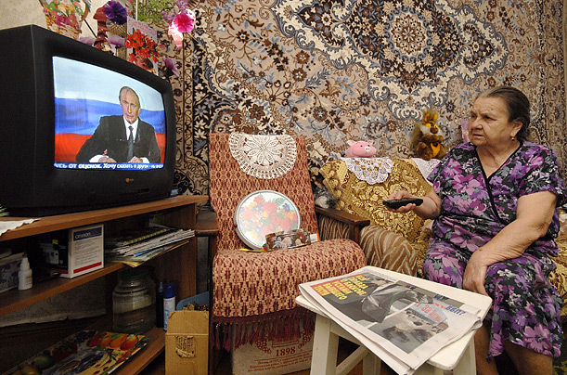
PUTIN’S SUPPORTERS

Slide 4
THE SOVIET PAST
Security and order
Stable prices, employment, housing
Predictable goods, services + problems
Seamless public information

Slide 5
+FALL OF USSR
Insecurity + unpredictability
Massive rise in unemployment + inflation
Fluid political system
Jump in inequality of wealth
Reduction in world influence

Slide 6
PUBLIC OPINION
February, 2001
Russia needs…
71% “a strong leader”
59% “a strong state”
13% “democratic institutions”
PATH DEPENDENCY

Slide 7
PUTIN’S GOALS
Establish AUTHORITY
Nurture charismatic
LEGITIMACY
Control the mechanisms of
POWER
Manage ELECTIONS
RESPOND to public needs

Slide 8
CULT OF PERSONALITY?
“I want a Man Like Putin”
Putin as a Super Hero
“The Stifled Opposition”
“Planning for the Future”

Slide 9
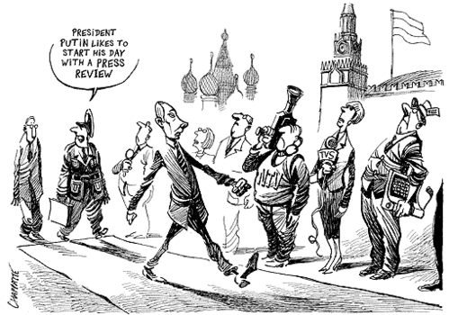
MASS MEDIA CONTROL
Freedom House Ranking
of Press Freedom
= “Not Free”
[175 of 196]
Attacks
on
Journalists

Slide 10
CONSOLIDATION OF
GOVERNMENT POWER
“All these challenges to Russia’s development can be overcome, only through more political competition, real rule of law and openness and transparency.”
Putin, Feb. 2012

Slide 11
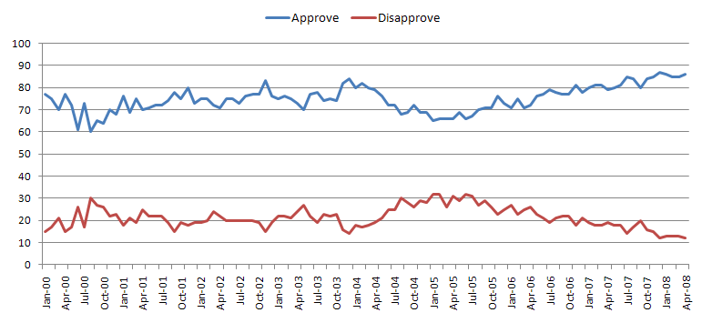
PUBLIC OPINION
Freedom House Ranking
NOT FREE
Political Rights: 6
Civil Liberties: 5

Slide 12
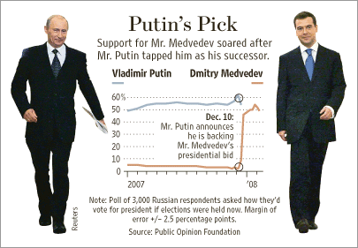
PUBLIC OPINION

Slide 13
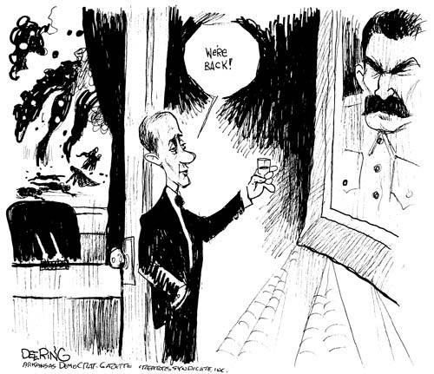
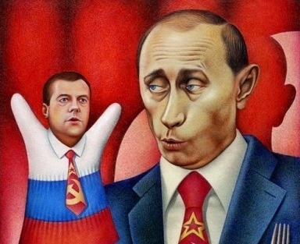
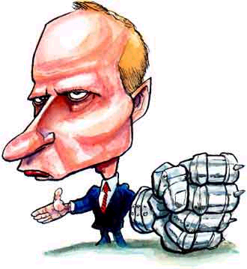

Slide 14
DOES RUSSIA NEED A MAN LIKE PUTIN?
Horrible demographics with a shrinking population
Pension and health care costs on the rise
Labor productivity in steady decline
New investments and non-oil industries are needed to keep up with the pace of spending
Ethnic diversity is putting a real strain on the country
Unrest and protests
Corruption

Slide 15
DOES RUSSIA NEED A MAN LIKE PUTIN?
What brings Russia stability?
Legitimacy?
Democracy?
Rule of Law?
1999 Price of Oil = $27 a barrel
2012 Price of Oil = $116 a barrel
A new group of Oligarchs loyal to Putin

Slide 16
DOES RUSSIA NEED A MAN LIKE PUTIN?

