Slide 1
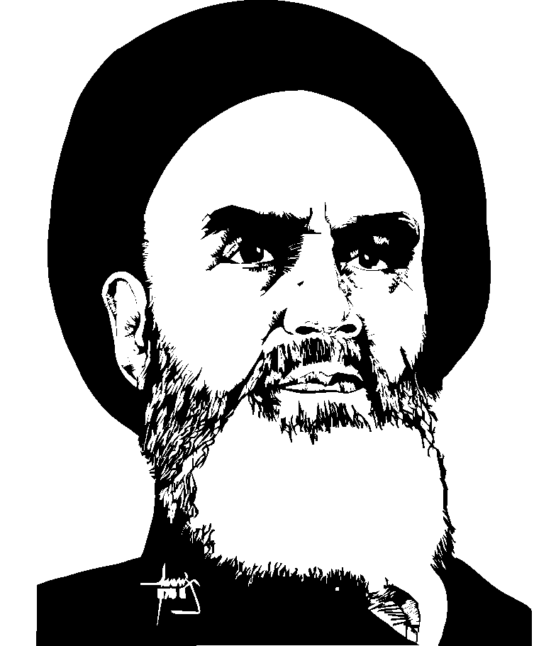
Timeline of key events leading up to the 1979 Revolution
Put your event card in order on the board

Slide 2
A broad sweep of Iranian History
The Persian Empire founded by Cyrus the Great in the 576 BC
Controlled much of the ancient world until Greece under Alexander the Great became the dominant power
Constant war…. (never a formal colony)
16th century Safavids Dynasty (Turkish)
18th century Qajar Dynasty (Turkish)
1925 Pahlavi Dynasty begins
1935 Persia becomes IRAN under Reza Shah

Slide 3
Persepolis
Written by Marjane Satrapi, great-grandaughter of Ahmed Shah (overthrown in 1925)
Pages 1 – 32 The Veil, The Bicycle, The Water Cell, Persepolis
Pages 40-46 The Party (downfall of the Shah)
Pages 62-79 The Sheep
Pages 72-79 The Trip
Pages 103- The Wine
The 1979 Revolution and the Islamic Regime

Slide 4
The Islamic Republic of Iran
Theocracy with democratic elements established in 1979
Led by a “Supreme Leader”
Unitary State
Dependent on oil revenue (Rentier State)
Shia Muslims (Shi'ites) = hereditary leaders are descendants of Muhammad
Conflict between conservatives and reformers

Slide 5
The Ayatollah Khomeini
Charismatic leader and author of the 1979 Constitution
“Leader of the revolution, founder of the Islamic Republic, Guide of the Oppressed Masses, Commander of the Armed Forces, and Imam of the Muslim World”

Slide 6
The White Revolution 1963
downfall of the Shah
1953 CIA brings the Shah back to power
1957 SAVAK created to torture dissents
Social and economic Westernization= intense popular opposition from ALL sides (Clerics and young protestors)
(Ayatollah Khomeini is arrested)
For 15 years in exile (Iraq, Kuwait, finally in France) he builds support for his Islamic vision…

Slide 7
“Iran and the West: The Man Who Changed the World” (Quiz)
What are the causes of the Iranian Revolution?
How was it a source of political change?
How does it parallel with China’s Cultural Revolution?
How does it help explain the US’s current relationship with Iran?

Slide 8
Causes and Success of the 1979 Revolution
Shah was perceived as totalitarian – no involvement from interest groups
Secularized Iran too fast
Ties to the West/President Carter - cleavage between modernization and Shiism
IV. Charismatic leadership of the Ayatollah Khomeini
Drop in oil prices (97% of Iran exports)

Slide 9
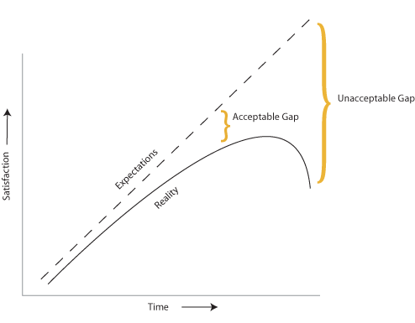
“J-Curve Theory” = Revolution

