Slide 1
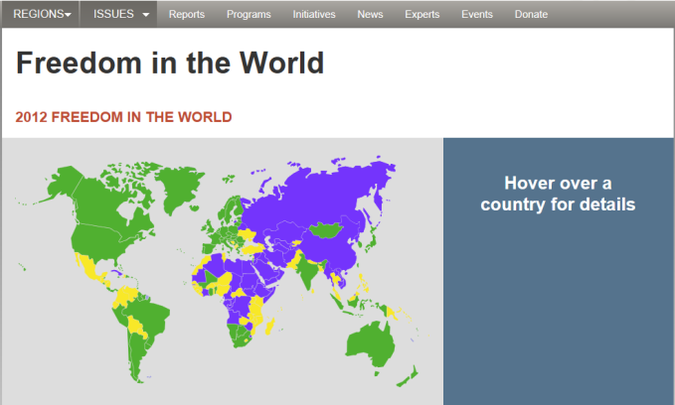
Freedom House Activity Directions 2013
Go to freedomhouse.org
Click on reports
Under Signature Reports, click Freedom in the World
Click on your assigned country and complete the chart in the packet. (Civil Liberties/Political Rights)
For each question, provide at least two examples to explain your response.

Slide 2
Freedom House Jigsaw Debrief
Provide
Political Rights Score
Civil Liberties Score
Freedom Status
Create a 1 sentence summary of their overall freedom status.
Be prepared to share with the class.

Slide 3
1
2
3
Follow the Menu: Analysis Tab >> Freedom in the World >> Map of the Freedom of the World
Select the latest report/edition: 2010 (Get the score from 2005 as well for comparison.)
Select your countries, one at a time.
Read the report that appears to answer the questions.
1 = most free and 7 = least free

