Slide 1
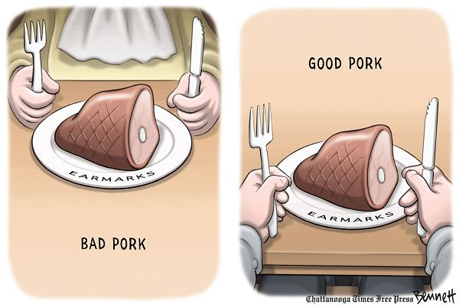

Slide 2
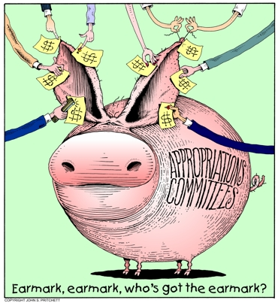
Pork Update
In 2010, Republicans vowed to stop all pork (also called earmarks) spending. (About .5% of the budget/$15 B per year).
In your opinion, what are
the consequences both
positive and negative?
http://www.cagw.org/reports/pig-book/2012/2012-pig-book.pdf
http://www.youtube.com/watch?v=QnlqRnfHgWA (LIVE PIG CLIP)

Slide 3
