Slide 1
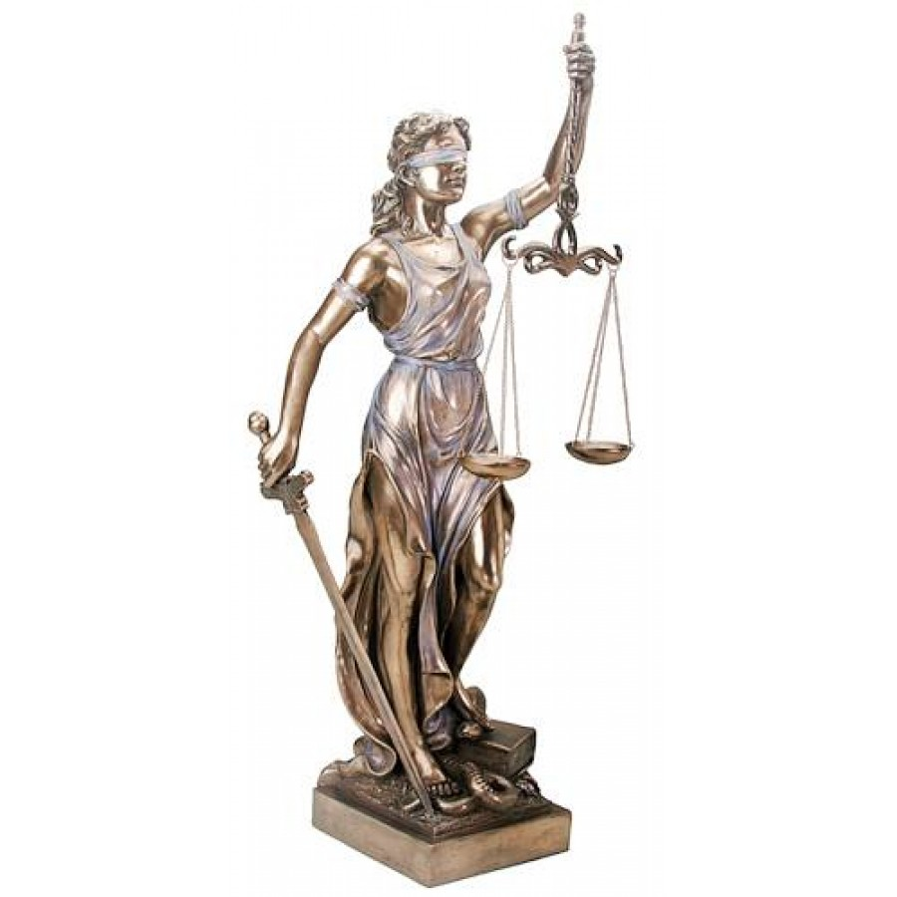
To begin…why is “justice blind?” What is “Rule of Law?”
Dual Court System & Introducing the Supreme Court

Slide 2
Court Hierarchy
Trial courts: Lowest level “courts of first instance;” original jurisdiction (first court to hear a case); judge or jury
Appellate courts: next level; appellate jurisdiction – reconsidering decisions of trial courts at request of losing party
Supreme Courts or Superior Courts: highest level; appellate or original jurisdiction

Slide 3
The Dual Court System
Key Question: Why do we need state courts AND federal courts?

Slide 4
US Court System – DUAL court System
STATE COURT SYSTEM
FEDERAL COURT SYSTEM
State Court Jurisdiction: Interpret and apply state and local laws – from murder to littering…
Structure varies from state to state; Illinois…
23 Circuit Courts (arranged by county, lowest level)
5 Appellate Courts (hear cases on appeal)
Illinois State Supreme Court (court of last resort)
Judges to state courts are elected
US District Courts – original jurisdiction; federal criminal and civil cases; courts to help Congress carry out powers (Tax Court, etc.)
US Court of Appeals – appellate jurisdiction; review all criminal and civil cases from district courts
US Supreme Court – “court of last resort;” highest court in the land; original and appellate jurisdiction
Federal Judges are appointed by president

Slide 5
The Dual Court System
United States Supreme Court
U.S. Court of Appeal (13)
Federal District Courts (94)
Illinois State Supreme Court
Illinois Appellate Court
Illinois Circuit Court (22)
Local Municipal Courts

Slide 6
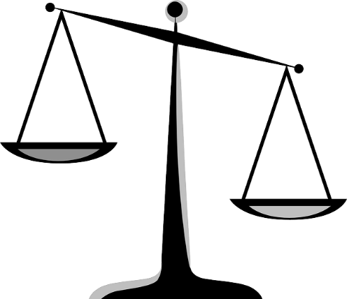
Big Ideas about the Judiciary: Striking a Balance with the Courts
How do these influence the cases the Supreme Court chooses to hear?
Rights of the Individual
Judicial Activism
Rights of Society
Judicial Restraint

Slide 7
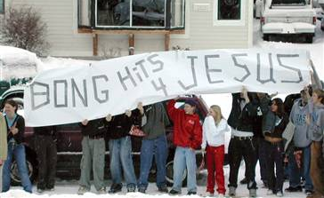
Morse v. Frederick (2007)
How to read a Supreme Court case
What happened? Case background of Morse v. Frederick
Read the decision in Morse vs. Frederick. Underline the main ideas in section A, B and C. What precedent was established in this case?

Slide 8
Morse v. Frederick (2007)
The Judicial Branch
With your pod…
Identify 3 reasons the students were right in holding their banner.
Identify 3 reasons the school was right for suspending the students.
Identify one key question you think the Supreme Court should have asked while ruling on this case

Slide 9
Justice Steven’s Dissent
“Admittedly, some high school students (including those who use drugs) are dumb. Most students, however, do not shed their brains at the schoolhouse gate, and most students know dumb advocacy when they see it. The notion that the message on this banner would actually persuade either the average student or even the dumbest one to change his or her behavior is most implausible.”

Slide 10
What does this tell us about our big ideas about the judiciary?
How effectively do you believe the Supreme Court balanced the rights of the individual against the rights of society in this case?
Do you think this ruling represents judicial activism or judicial restraint?
Key question: Why choose this case?
Submit to Google Classroom
Tomorrow…how cases reach Supreme Court, how Court selects cases

