Slide 1
The Executive Branch
THE FEDERAL BUREAUCRACY
“All the President’s Men and Women”
(But, don’t forget that Congress has the
Power of the Purse and Oversight!)

Slide 2
The Federal Bureaucracy
“Rule by Desks” - How do they effect you?
EPA Inspector
IRS Agent
FDA Inspector
Intelligence officer of the CIA
OSHA Inspector in your work place
TSA Agent at the airport

Slide 3
Bureaucracy
Hierarchical
Authority
Job Specialization
Formalized Rules
Close to 3 MILLION PEOPLE (85% work outside of DC)
“I cannot even see all of these men, let alone actually study what they are doing.”
- President Truman

Slide 4
Inherent Conflicts in the Bureaucracy
Fairness v.
Responsiveness
Professional Independence v. Accountability
Efficiency v.
Effectiveness
Which do we want from our bureaucrats? Circle one
Our Bureaucracy is ESSENTIAL, they have EXPERTISE, DISCRETION with POLICY IMPLEMENTAION and rely on CLIENTELE GROUPS.

Slide 6
President
White House Office
The “West Wing”
Direct advisors
Personal Staff
Appointment
Rule of
Propinquity

Slide 7
President
White House Office
The “West Wing”
Direct advisors
Personal Staff
Appointment
Collect info, advise/report
Implement policies
Appointed + confirmed
Chief of Staff, Press Sec
NSA, OMB, Trade Rep
Executive Office of the President

Slide 8
President
White House Office
The “West Wing”
Direct advisors
Personal Staff
Appointment
Collect info, advise/report
Implement policies
Appointed + confirmed
Chief of Staff, Press Sec
NSA, OMB, Trade Rep
Executive Office of the President
Executive
Departments
The Cabinet, Secretaries
Implement + enforce laws
Appointed + confirmed
“Agency Point of View”
State, Defense, Treasury

Slide 9
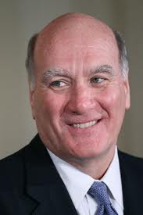
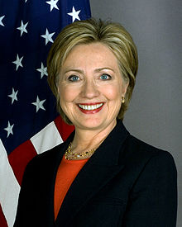
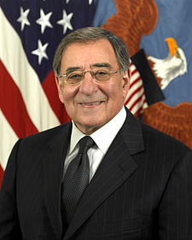
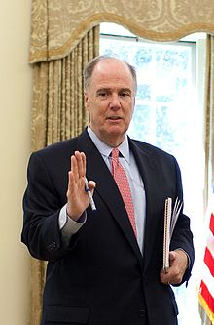
Top Advisors
Chief of Staff
Bill Daley
Secretary of State
Hillary Clinton
Secretary of Defense
Leon Panetta
National Security Advisor
Tom Donilon

Slide 10
President
White House Office
Independent Agencies
CIA, FEMA
Executive Office of the President
Executive
Departments

Slide 11
President
White House Office
Independent Agencies
CIA, FEMA, NASA
Appointed
+ confirmed
-Intended not to be
political (long tenure)
Regulatory Agencies
Very specific functions, long,
staggered terms
Ability to punish, should be
outside of political control
- EPA, FCC, SEC, FEC
Executive Office of the President
Executive
Departments

Slide 12
President
White House Office
Independent Agencies
Appointed
CIA, FEMA
Regulatory Agencies
EPA, FCC
SEC, FEC
Executive Office of the President
Government
Corporations
Executive
Departments
USPS, FDIC
Amtrack
Quasi-
Independent
Fixed Terms

Slide 13
Types of Employees
Careerist
Politician
Professional
Our Bureaucracy is ESSENTIAL, they have EXPERTISE, DISCRETION with POLICY IMPLEMENTAION and rely on CLIENTELE GROUPS.
Merit v. Patronage System
(Spoils System under Jackson)

Slide 14
I. What type of employee should the President appoint and why?
II. Rank their importance to the President. Be prepared to justify your answer.
___ White House Staff (___________)
___ EOP (___________)
___ Exec. Departments (___________)
___ Indep. Agencies (___________)
___ Reg. Agencies(___________)
___ Govt. Corporations (___________)
(Type of Employee)
Professional
Rank
Careerist
Politician

Slide 15
The Federal Bureaucracy
Professionalism
“Civil Service”
Pendleton Act
“Neutral Competence”??
Accountability
Sunshine Acts: Freedom of Information, Open Meeting Law
Congressional Oversight
Appropriations
Lawsuits
Whistle Blowing
Power
Discretionary Authority
Rulemaking
Clientele Groups
Iron Triangles
Issue Networks

