Slide 1
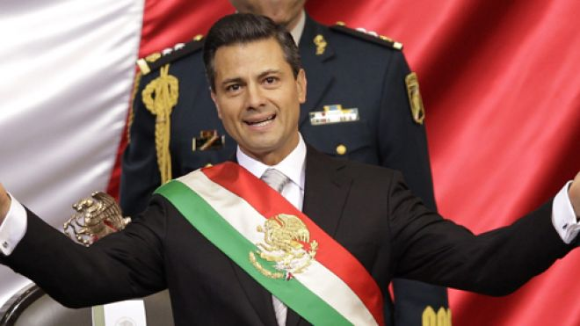
Mexico’s Presidential Election 2012
Old party, new start?

Slide 2
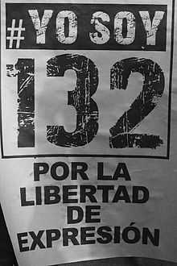
Civil Society and the Election of 2012
Role of the Media
1. Student Protest Movement
#Yosoy132
Started when Pena Nieto was Governor in 2006 (crack down on student protesters 2 killed)
2. Pena Nieto was favored by the only two national networks (Televisa & TV Azteca)
Violations of Mexican Election Laws
(3 month campaign by law/Ban on negative ads)
2nd wife is a soap star on the network

Slide 3
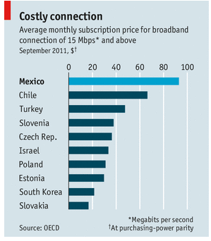
What would this data tell us about voter turnout in Mexico?

Slide 4
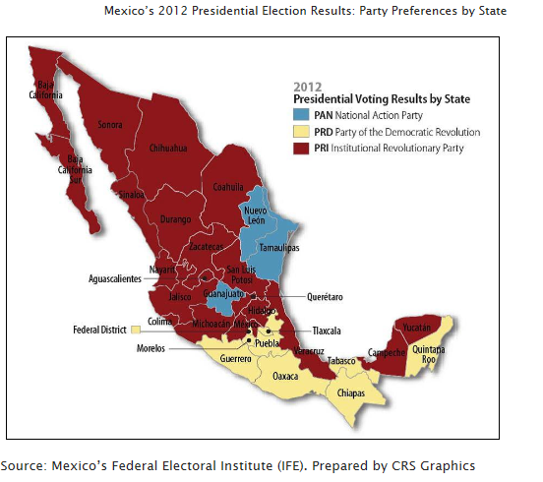
Election Results
PRI = 38.21%
PRD = 31.59%
PAN = 25.41%
Start with #4
http://www.google.com.mx/elections/ed/mx/results

Slide 5
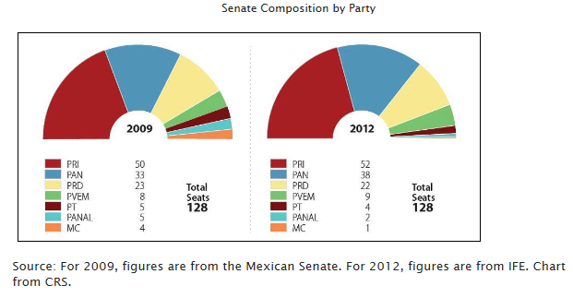

Slide 6
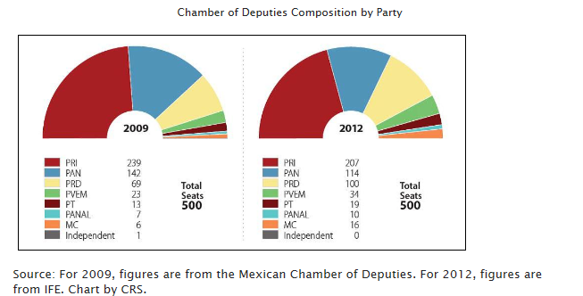
**In the Chamber of Deputies 200 seats are PROPORTIONAL and 300 SMD
Election law requires that 30% of the party list must be women

Slide 7
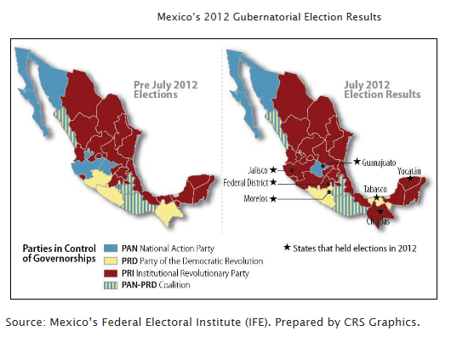

Slide 8
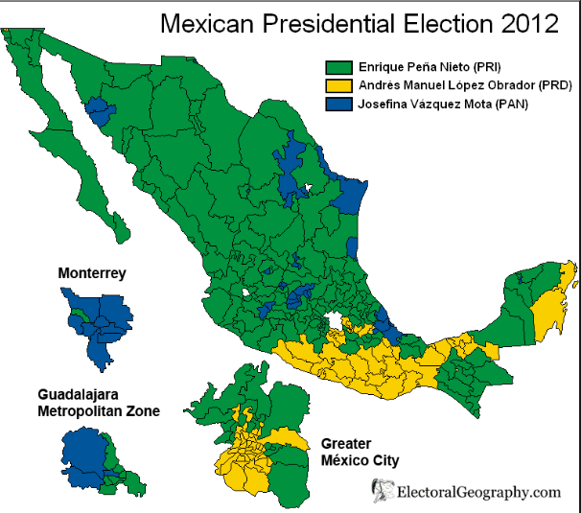
http://www.google.com.mx/elections/ed/mx/results

Slide 9
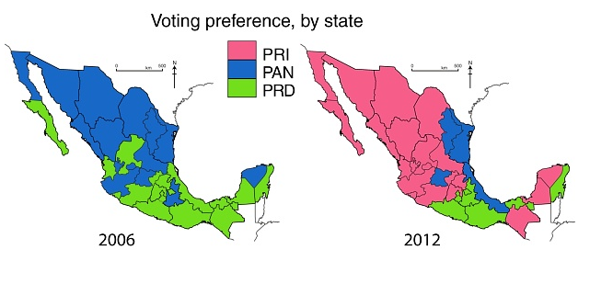

Slide 10
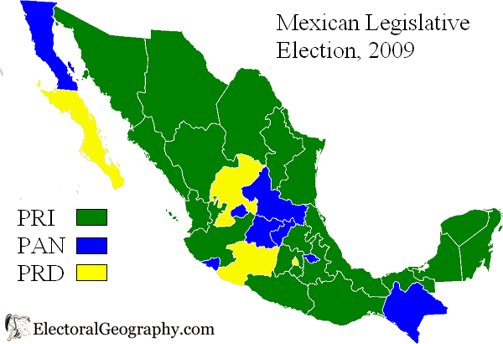

Slide 11
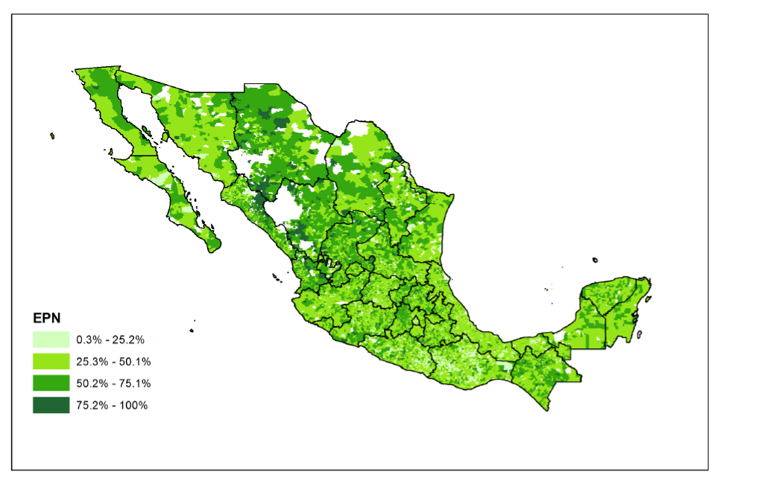
Enrique Peña Nieto
(PRI) 38.21%
2012

Slide 12
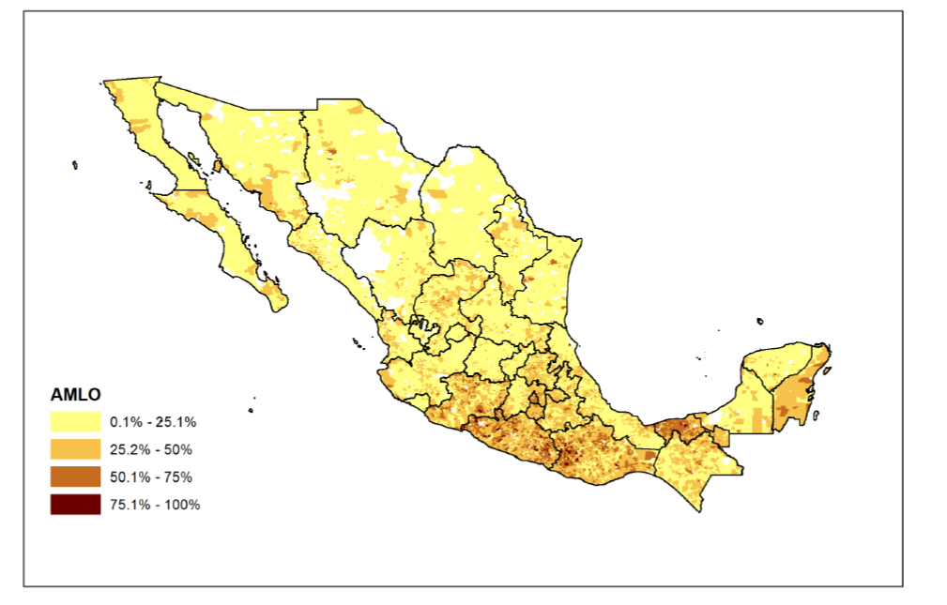
Andrés Manuel López Obrador (PRD) 31.59%
2012

Slide 13
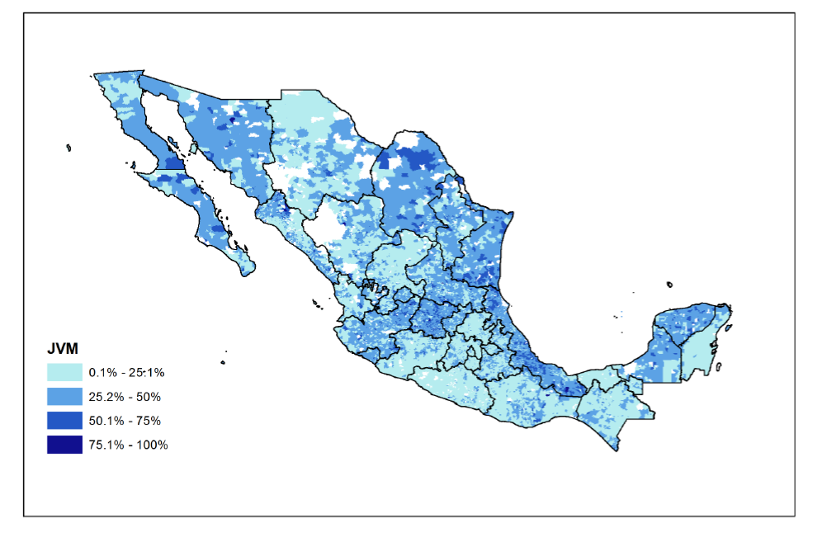
Josefina Vázquez Mota (PAN) 25.41%
2012

Slide 14
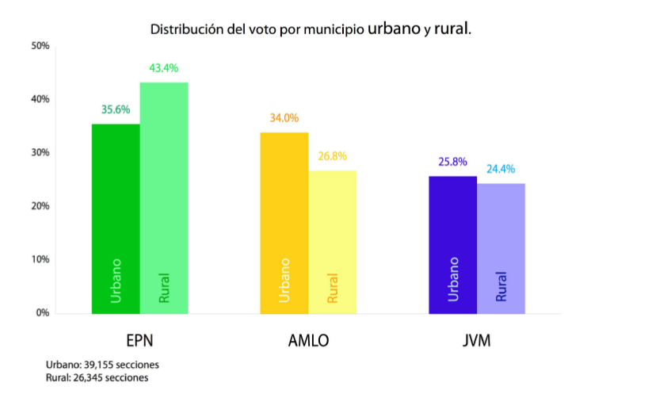
2012

Slide 15
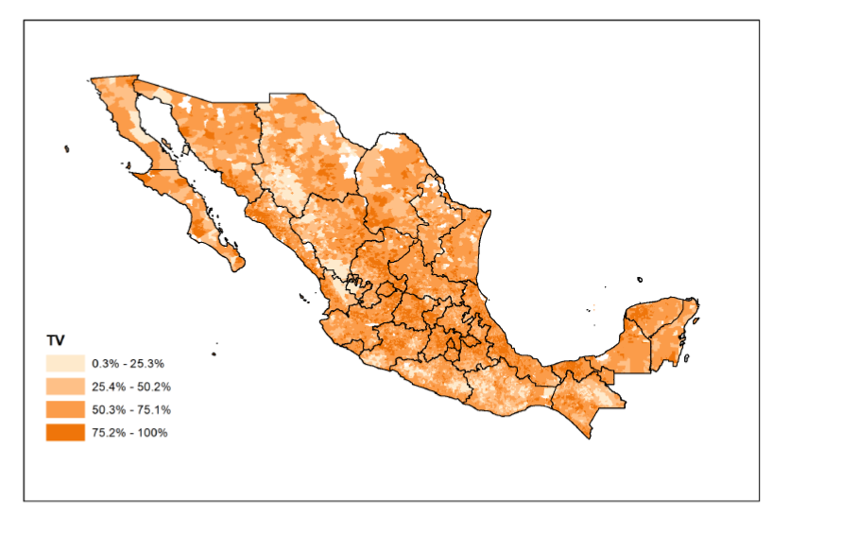
% with TV access
2012

Slide 16
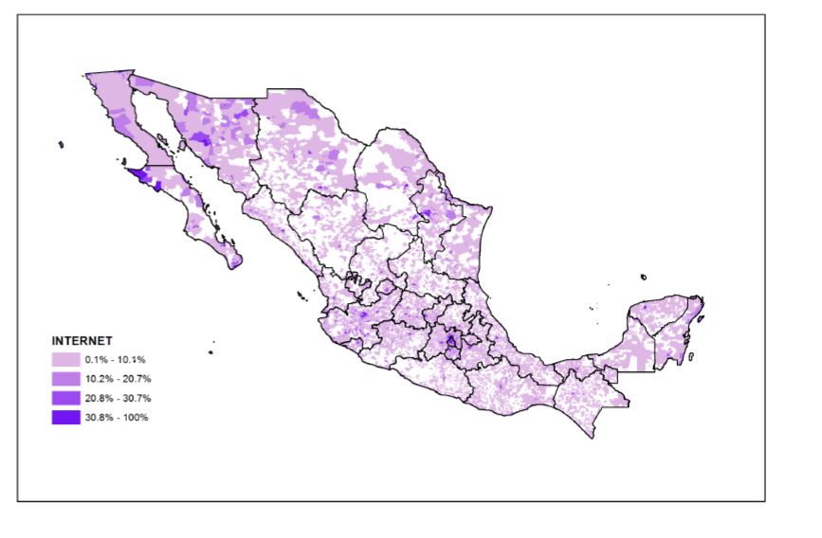
% with internet access
2012

Slide 17
Voter Turnout in Mexico
*Prior to 1990’s VERY high turnout =
Patron-Client Networks
Camarillas
(The PRI challengers were defeated with “tacos” ie: stuffed ballot boxes; moved polling locations, pressured voters)
1994 78%
2000 64%
2006 60%
2012 62%
Federal Election Institute created in 1997

Slide 18
Exit Slip
Explain why did the PAN lose to the PRI in 2012?

Slide 19
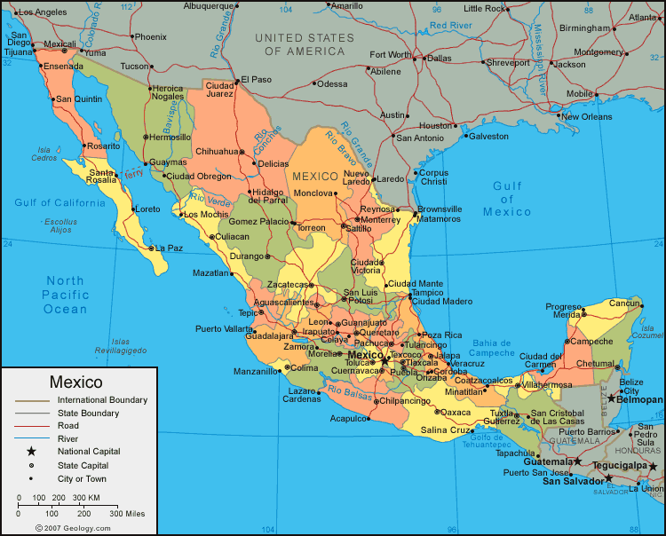

Slide 20
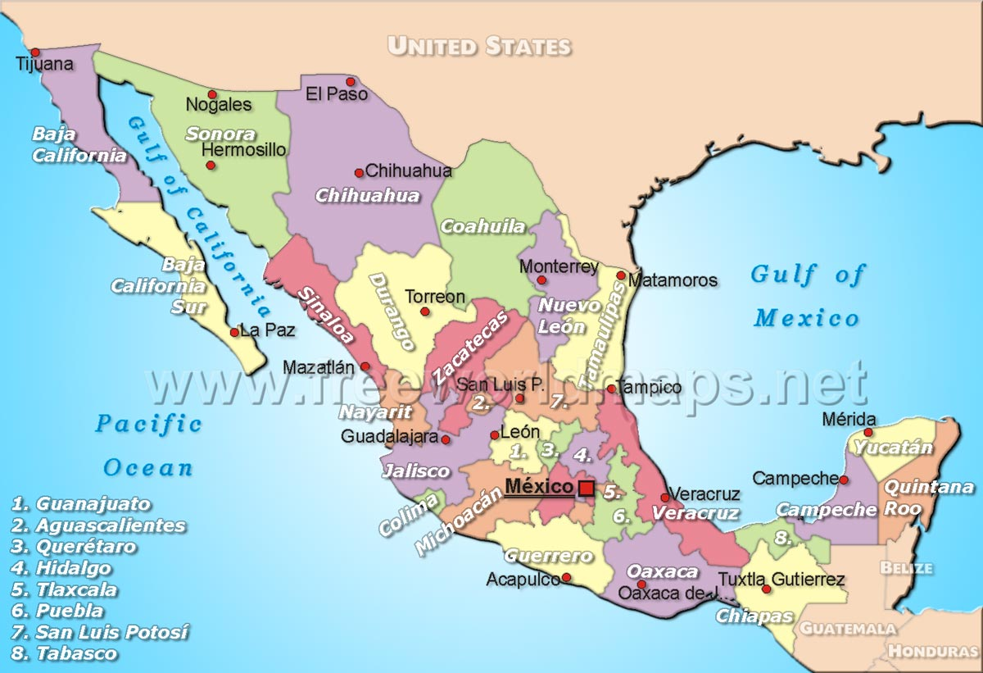

Slide 21
http://www.google.com.mx/elections/ed/mx/results

Slide 22
Resources Used
The Mexico Institutes Election Guide
http://mexicoinstituteonelections.wordpress.com/2012/07/02/five-take-aways-from-the-mexican-election/#more-1768
http://www.google.com.mx/elections/ed/mx/results (AWESOME - shows voter turnout in each state)
http://welections.files.wordpress.com/2012/07/mexico-2012.png
http://www.google.com/url?sa=t&rct=j&q=&esrc=s&frm=1&source=web&cd=2&ved=0CEEQFjAB&url=http%3A%2F%2Fiis-db.stanford.edu%2Fpubs%2F23882%2F2012ElectionReport.pdf&ei=WOM_Ueb5NOTn2QWZxoCADw&usg=AFQjCNFxhak00AFd2o0A4tujRkqFFyfbew&bvm=bv.43287494,d.b2I (Great Election Analysis)

