Slide 1
Defining the 1st Amendment
“Freedom to think as you will
and to speak as you think
are means indispensable to
the discovery and spread of
POLITICAL TRUTH.“
- Justice Louis Brandeis (1927)

Slide 2
Defining the 1st Amendment
In our Civil Society, the Supreme Court will consider:
Is the government’s action/law reasonable?
Is there equal protection for both parties?
Is government’s action/law neutral?
What actions took place or was the speech just words/beliefs?
Is there a balance between the rights of the individual and the rights of society?

Slide 3
Defining the 1st Amendment
In our Civil Society, the Supreme Court will consider:
Is the government’s action/law reasonable?
Is there equal protection for both parties?
Is government’s action/law neutral?
What actions took place or was the speech just words/beliefs?
Is there a balance between the rights of the individual and the rights of society?

Slide 4
1st Amendment Limitations and Tests
“Clear and Present” Danger Test
(Schenck v. U.S.)
1919 upholds the Espionage Acts (active opposition to war = crime) 1st Amendment rights are NOT absolute
Remember, “Congress shall make no law…”
1st Amendment did not apply to the states until 1925 with Gitlow v. NY
Selective Incorporation

Slide 5
1st Amendment Limitations and Tests
“Direct Incitement” Test
(Brandenburg v. Ohio, 1969)
Strongest protection for free speech
(KKK rally filmed by a reporter and shown on local news)
“Imminent lawless action”
(Test used today)

Slide 6
1st Amendment Limitations and Tests
Texas v. Johnson, 1989 (5 to 4) Flag burning
RAV v. St. Paul, 1992
Can you burn a cross on someone’s front lawn?
“Viewpoint Discrimination”

Slide 7
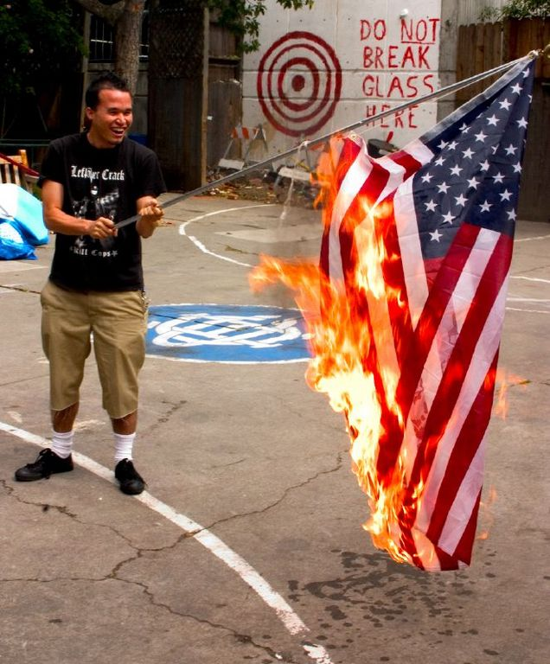
1st Amendment Limitations and Tests
Texas v. Johnson, 1989 (5 to 4) Flag burning
Describe the court’s rationale. How is this case similar or different from Brandenburg v. Ohio?

Slide 8
1st Amendment Limitations and Tests
Obscenity can be banned
Roth v. United States, 1957 (“community standards”) bookseller mailing obscene materials
Miller v. California, 1973
“Miller Test”
Clarified by adding “local” community standards
Does the work lack serious literary, artistic, political or scientific value?

Slide 9
1st Amendment Limitations and Tests
Why is this case different?
9-0 in favor of the ACLU
Reno v. ACLU (1997) Communications Decency Act (made it a crime to distribute “indecent” material over the web)

Slide 10
1st Amendment Limitations and Tests
Freedom of the Press Cases
Near v. Minnesota (1931) – established the doctrine of prior restraint (5 to 4)
New York Times v. US (1971) – original jurisdiction case (argued June 26th, decided June 30th) (6-3)

Slide 11
1st Amendment Limitations and Tests
Freedom of the Press Cases: School
Fujishima v. Board of Education (7th Cir. 1972) students passed out an underground newspaper “The Cosmic Frog” - Appeals Court agreed with the students
Hazelwood v. Kuhlmeier (1988) student newspapers are subject to a different standard – reasonable to protect students (6 to 3)
" Educators did not offend the First Amendment by exercising editorial control over the content of student speech so long as their actions were "reasonably related to legitimate pedagogical concerns."

Slide 12
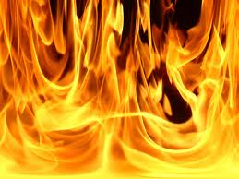
1st Amendment Limitations and Tests
RAV v. St. Paul, 1992
9-0 decision
“Let there be no mistake about our belief that burning a cross is someone’s yard is reprehensible. But St. Paul has sufficient means as its disposal to prevent such behavior without adding the First Amendment to the fire.” – Justice Scalia
Ordinance was vague and overly broad
Hate Speech

Slide 13
1st Amendment Limitations and Tests
The Government can regulate indecency and can prohibit obscenity
Hustler Magazine v. Falwell, 1988
8-0 http://www.youtube.com/watch?v=MeTuNES82O0
Libel = printing false material
Slander = speaking false material
There is a different Standard for public figures: requires proof of actual malice and a “reckless disregard for the truth” (New York Times v. Sullivan, 1964)

Slide 14
1st Amendment Limitations and Tests
Test Yourself?
Can the government prohibit the sale of violent video games to children under the age of 18?

Slide 15
1st Amendment Limitations and Tests
Brown v. Entertainment Merchant Association (2011) 7 to 2
No
“Video games communicate ideas – even social messages…” - Justice Scalia

Slide 16
1st Amendment Limitations and Tests
Test Yourself?
Are protesters at military funerals protected under the 1st Amendment?
http://abcnews.go.com/WNT/video/supreme-court-rules-hate-chanting-protesters-first-amendment-military-funerals-politics-13042548

Slide 17
1st Amendment Limitations and Tests
Time, Place and Manner
Can a neo-Nazi group march through Skokie?
“Viewpoint Discrimination”

Slide 18
1st Amendment Limitations and Tests
Time, Place and Manner
Yes
“Viewpoint Discrimination”

Slide 19
1st Amendment Limitations and Tests
Test yourself!
What are the limitations in schools?
What are the limitations on the press?

Slide 20
1st Amendment Limitations and Tests
Establishment Clause
Wall of Separation between church and state
“Lemon Test” Lemon v. Kurtzman, 1971
The government's action must have a secular legislative purpose;
The government's action must not have the primary effect of either advancing or inhibiting religion;
The government's action must not result in an "excessive government entanglement" with religion.

Slide 21
1st Amendment Limitations and Tests
Test Yourself! Establishment Clause
Can Congress open their session with a prayer?
Can a student lead a prayer at a school graduation?
Can schools allow student-led prayer before a high school football game over the loudspeaker?
Can a courthouse display the Ten Commandments?
Can a crèche be displayed outside of city hall?
Can a Christmas tree be displayed outside of a publicly funded hospital?
Can tax dollars support a deaf interpreter at a parochial school?

Slide 22
1st Amendment Limitations and Tests
Test Yourself! Establishment Clause
Can Congress open their session with a prayer? YES
Can a student lead a prayer at a school graduation? YES
Can schools allow student-led prayer before a high school football game over the loudspeaker? NO
Can a courthouse display the Ten Commandments? NO
Can a crèche be displayed outside of city hall? NO
Can a Christmas tree be displayed outside of a publicly funded hospital? YES
Can tax dollars support a deaf interpreter at a parochial school? YES

Slide 23
1st Amendment Limitations and Tests
Free Exercise Clause
Freedom of belief is absolute, but the government may regulate your behavior to promote public safety
One of the most consistently protected freedoms

Slide 24
1st Amendment Limitations and Tests
Wisconsin v. Yoder (1971)
Amish may keep their children out of school after the 8th grade
Compelling state interest
“Sincerity of their religious beliefs”
“Three centuries as an identifiable religious sect”

Slide 25
1st Amendment Limitations and Tests
West Virginia v. Barnette (1943)
The state cannot force Jehovah’s Witnesses to recite the pledge. (6 to 3)
“Words uttered under coercion are proof of loyalty to nothing but self-interest.” - Justice Black

Slide 26
1st Amendment Limitations and Tests
Test yourself! Free Exercise Clause
Can religion serve as the basis to obtain “conscientious objector” status to avoid the draft?
Is animal sacrifice as part of a religious ceremony protected by the 1st Amendment?
Do the Amish need to follow traffic laws and put license plates and reflectors on their buggies?
Can religious meetings in public parks be regulated?
May a city ban door-to-door religious canvassing?
Can Christian Scientists be compelled to take drugs?

Slide 27
1st Amendment Limitations and Tests
Test yourself! Free Exercise Clause
Can religion serve as the basis to obtain “conscientious objector” status to avoid the draft? YES
Is animal sacrifice as part of a religious ceremony protected by the 1st Amendment? YES
Do the Amish need to follow traffic laws and put license plates and reflectors on their buggies? YES
Can religious meetings in public parks be regulated? YES
May a city ban door-to-door religious canvassing? NO
Can Christian Scientists be compelled to take drugs? NO… but their children can if the state steps in

